Slide 1
CGB1221-DATABASE MANAGEMENT SYSTEM
Department of Artificial Intelligence and Data Science
Academic Year: 2024 – 2025
Register Number : 2303811724322089
Name : Rexcia A
Year : II
Semester : IV
Section : B
Date : 02.06.2025

Slide 2
Title of the Project
VEHICLE PARKING
MANAGEMENT SYSTEM

Slide 3
Problem Identification
Manual parking management is time-consuming and error-prone.
No real-time tracking of available parking slots.
Difficulty in maintaining accurate vehicle records.
Entry/exit processes lack automation
Security risks due to lack of vehicle verification.
No proper reporting or data analysis system..

Slide 4
Objective
Automate the vehicle parking process to reduce manual work.
Maintain accurate records of vehicle entries and exits.
Provide real-time tracking of available and occupied parking slots.
Enhance security by verifying vehicle and owner details.
Generate reports for parking usage, time logs, and billing.
Improve efficiency and organization of parking management.

Slide 5
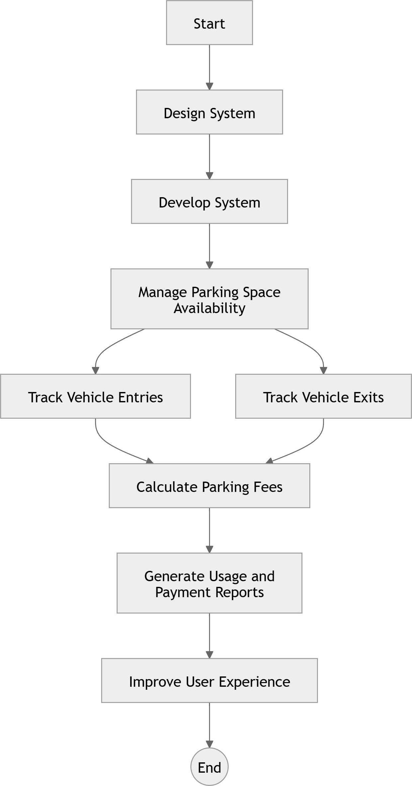
Proposed Architecture

Slide 6
List of Modules
Parking Space Management Module
Vehicle Entry & Exit Management Module
Parking Fee Calculation & Payment Module
Reporting & Analytics Module

Slide 7
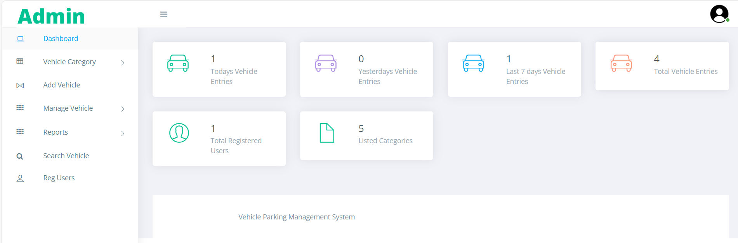
Module Description
Parking Space Management Module: This module tracks real-time parking slotavailability, updating the database with occupied and vacant spaces to ensure efficient space utilization. It assigns slots based on vehicle type and availability,preventing overcrowding and mismanagement.

Slide 8
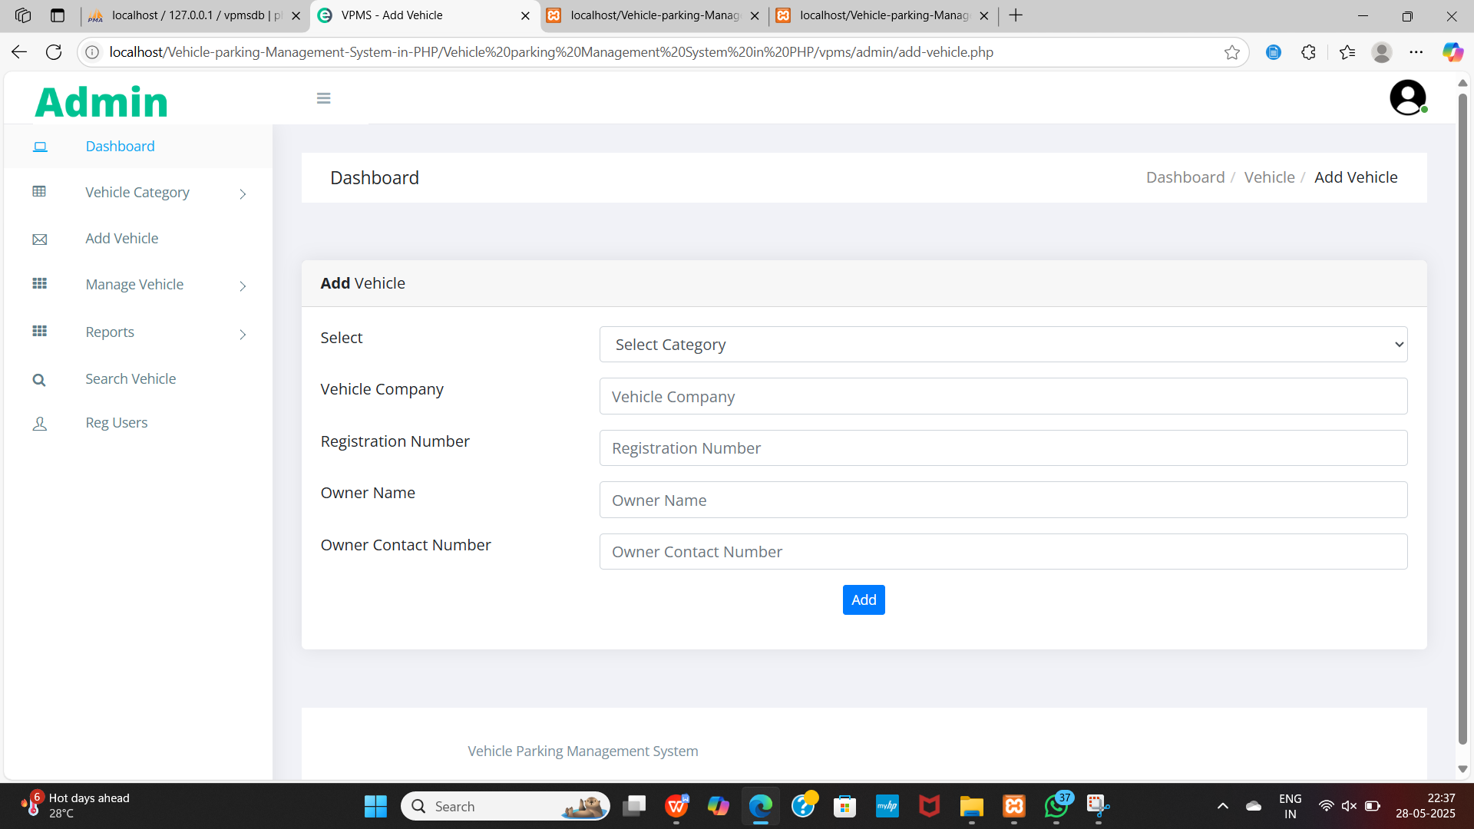
Module Description
Vehicle Entry & Exit Management Module: This module records vehicle details, including license plate numbers and timestamps, to monitor entries and exits. Thedatabase stores this information for tracking parking duration and ensuring accurate log maintenance.

Slide 9
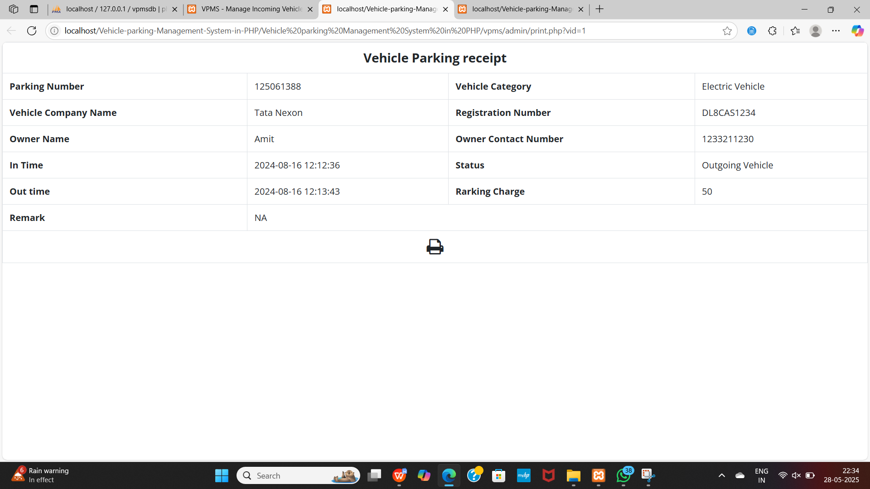
Module Description (Cont..)
Parking Fee Calculation & Payment Module: This module calculates parking charges based on duration and predefined rates, ensuring transparent billing. It processes payments through various methods and maintains transaction records for financial accuracy.

Slide 10
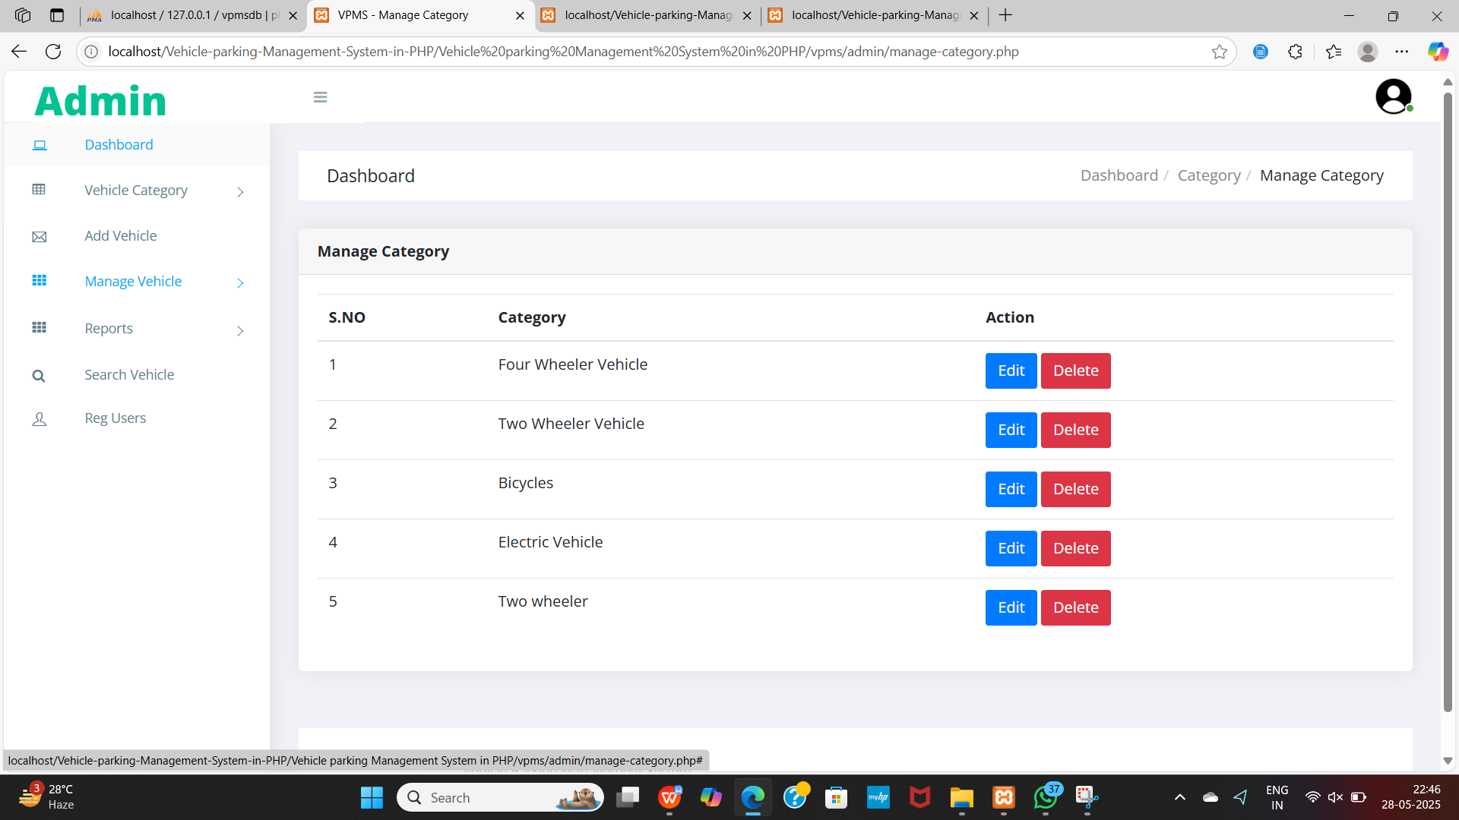
Module Description (Cont..)
Reporting & Analytics Module: This module generates reports on parking usage, revenue collection, and peak hours by analyzing stored data. It helps administrators make data-driven decisions to optimize parking space and improve operational efficiency.

Slide 11
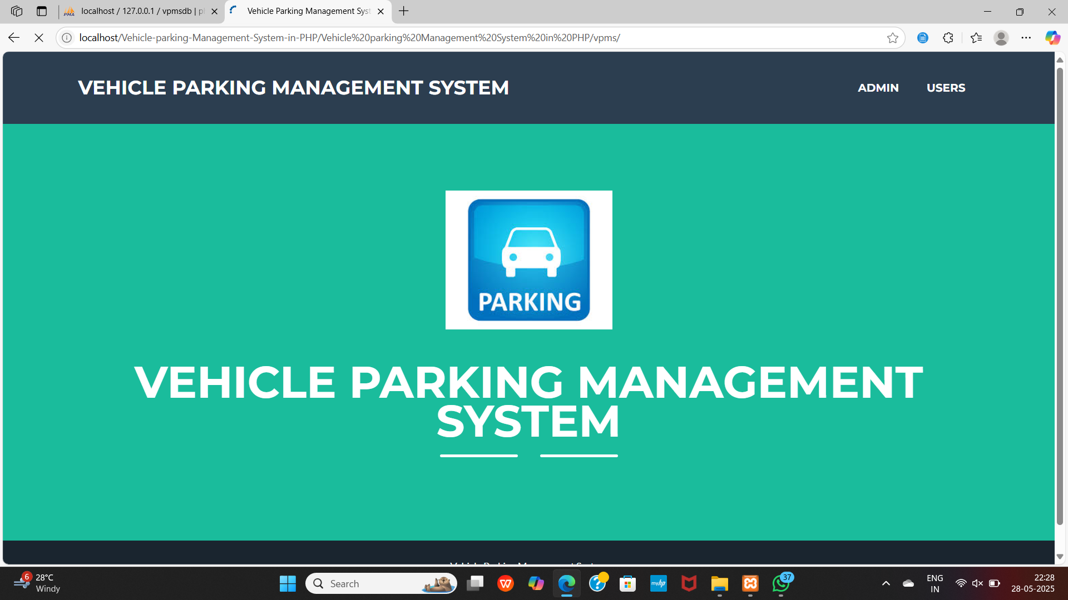
Results

Slide 12
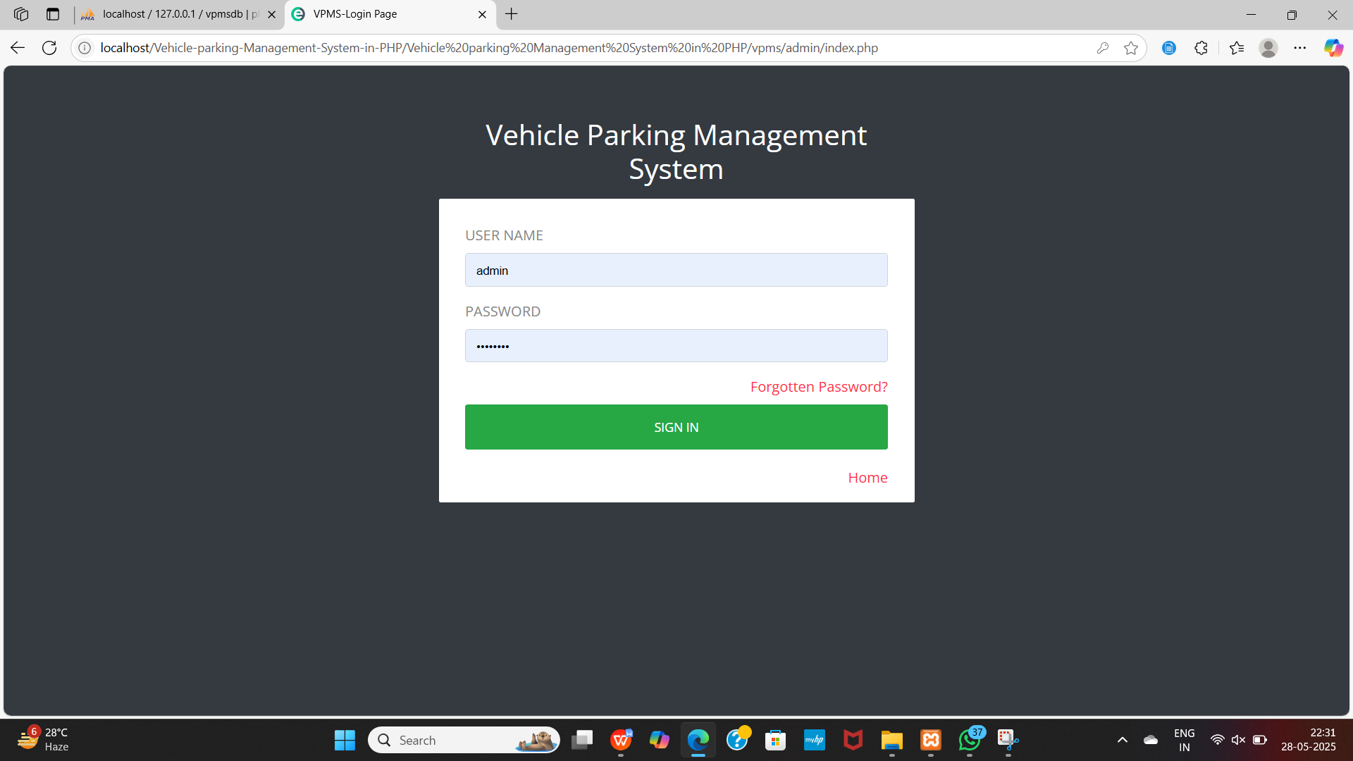
Results

Slide 13
Conclusion
The Vehicle Parking Management System (VPMS) using DBMS enhances parking efficiency by automating space tracking, vehicle entry/exit logging, and fee calculation. It ensures accurate data management, secure transaction processing, and detailed reporting for better decision-making. By reducing manual errors and improving user convenience, VPMS optimizes parking operations, enhances revenue management, and provides a seamless parking experience.

Slide 14
Advantages
Efficient Parking Management – Automates slot allocation and tracking.
Time-Saving – Speeds up vehicle entry and exit processes.
Real-Time Monitoring – Shows live status of parking slot availability.
Improved Security – Records vehicle and user details for verification.
Easy Record Keeping – Maintains digital logs of all parking activities.
Report Generation – Provides usage, billing, and time-based reports.
User-Friendly Interface – Simple system for admins and users to operate.

Slide 15
Thank You
Any queries???

